Slide 1
Environmental Cleaning and Disinfection for Community Facilities

Slide 2
Objective
Describe basic principles of cleaning and disinfection
When to use cleaning or disinfection
How to perform cleaning and disinfection of facilities
Environmental cleaning resources

Slide 3
COVID-19
COVID-19 is a virus spread mainly by coughing, sneezing or direct contact with a sick person, or with surfaces they have recently touched.
These droplets are large and can travel up to 2 meters, landing on objects and surfaces around the person. People then catch COVID-19 by touching these objects or surfaces, then touching their eyes, nose or mouth.
How do we control the spread within our facilities
Performing hand hygiene
Respiratory Etiquette (Cover coughs and sneezes with tissue or cough into flexed arm)
Wearing appropriate personal protective equipment (PPE)
Do effective ENVIRONMENTAL CLEANING
Reference: Alberta Disease Management Guidelines

Slide 4
How long does the virus survive on surfaces?
It is not certain how long this virus survives on surfaces, but it seems to behave like other coronaviruses.
Studies suggest that coronaviruses (including preliminary information on the COVID-19 virus) may persist on surfaces for a few hours or up to several days.
This is dependent on:
Surface type
Temperature
Humidity
If you think a surface may be contaminated easy or is know to be contaminated, clean then disinfect it frequently
Reference: World Health Organization (March 9, 2020). Q&A on coronaviruses (COVID-19). Retrieved from https://www.who.int/news-room/q-a-detail/q-a-coronaviruses

Slide 5
Developing an Environmental Cleaning and Disinfection Program
An environmental cleaning program describes the set of policies, procedures and interventions in which to ensure consistent cleaning and disinfection within a facility
Identification of Equipment and General Patient Areas
Supplies and equipment for environmental cleaning
Cleaning and disinfection products, mops, brooms, vacuums, and cloths
General cleaning techniques for all equipment and areas
Personal Protective Equipment required (based on manufacturer’s or additional precautions)
Person/Staff Responsible
Determine minimum cleaning frequency
Develop templates for records to verify completion
Ensure provide training to all cleaning staff on how to implement the Cleaning and Disinfection program based on the standards and protocols set.
Notes:
What is important for your facility is to ensure that you develop an environmental cleaning and disinfection program. This program describes the set of policies, procedures and interventions in which to ensure consistent cleaning and disinfection of surfaces, and equipment within your facility.
What should be included
Reference: CDC (March 2020) Coronavirus Disease 2019 9COVID-19) Environmental Cleaning and Disinfection Recommendations
CDC (November 2019) Best Practice for Environmental Cleaning in Health Care facilities: in Resource-limited settings

Slide 6
Facility Specific Standards and Protocols
Define roles and responsibilities (e.g. the assignment of cleaning tasks/specific equipment) for a specific area.
Ensure non-environmental services cleaning staff have necessary supplies (e.g. ready-to-use disinfectant wipes, pre-mixed disinfectant solution, buckets, and cloths) to perform urgent cleaning tasks after hours.
Define regular cleaning and disinfection tasks and those performed on an as needed basis.
Include a method to differentiate clean items from soiled items.
Designate separate areas for handling/storing clean and soiled items.
Choose cleanable materials and finishes that are smooth, non-porous, water resistant, durable, and compatible with facility cleaning and disinfection products.
Include a process for identifying and reporting damaged (e.g. scratched, chipped, or torn) surfaces that impair effective cleaning and removing them from service.

Slide 7
Factors that impact recommended cleaning frequencies
Frequency of touch
Likelihood of contamination based on usual or expected activities
Patient population.
Areas are classified as very high, high, moderate, and low risk depending on patient population, activities being performed and microbial load.
Level of communicable disease activity (e.g. outbreak):
Increase the frequency of cleaning and disinfection of high touch surfaces
Clean and disinfect the room and equipment when a patient is taken off Additional Precautions (unless Additional Precautions removed because patient tested negative and has no positive history).
Clean and disinfect all affected areas at the end of the outbreak.

Slide 8
Environmental Cleaning and Disinfection Methods

Slide 9
Cleaning
Cleaning is the physical removal of visible soiling (e.g., dust, soil, blood, mucus). Cleaning removes, rather than kills, viruses and bacteria. It is done with water, detergents, and steady friction with a clean cleaning cloth/towel/mop.
Cleaning for COVID-19 virus is the same as for other common viruses. In general, cleaning should be done whenever surfaces are visibly soiled.
Surfaces must first be cleaned prior to disinfection (2 step process).
Source: AHS (July 2019). Guidelines for Outbreak Prevention, Control and Management in Supportive Living and Home Living Sites

Slide 10
Cleaning
There is a lack of specific evidence for the effectiveness of specific cleaning products against COVID-19.
For this reason:
Enhanced environmental cleaning using facility approved reagents is recommended. The thoroughness of cleaning is more important
Equipment should be cleaned and disinfected only with products and procedures outlined in the manufacturer’s directions for that equipment.
Source: AHS (July 2019). Guidelines for Outbreak Prevention, Control and Management in Supportive Living and Home Living Sites

Slide 11
Disinfection
Disinfection is the inactivation (killing) of disease producing microorganisms (viruses and bacteria) through wetting of a surface with a ready-to-use disinfectant wipe or cloth saturated with a disinfectant solution prepared according to the manufacturer’s instructions for use. This is most effective after surfaces are cleaned. A disinfectant is only applied to objects; never on the human body. To achieve disinfection, the surface must stay wet for the manufacturer’s recommended contact time.
Disinfectants to be used in healthcare facilities are products that are:
approved by Health Canada
and have a Drug Identification Number or DIN
If the disinfectant product used has cleaning properties (detergent/disinfectant) it may be used for both steps. Follow manufacturer’s directions for use.
*** Most household products are not approved to be used in healthcare facilities.
AHS (June 2017). Best Practice Guidelines: IPC PRINCIPLES FOR ENVIRONMENTAL CLEANING AND DISINFECTION

Slide 12
Disinfection
Public facilities should have existing policies to disinfect high-touch surfaces at least once per day; if not, these should be developed.
Consider more frequent disinfection whenever respiratory illnesses are circulating in the facility.
As well, additional disinfection should occur in any settings occupied by a symptomatic individual and at risk of COVID-19.
AHS (June 2017). Best Practice Guidelines: IPC PRINCIPLES FOR ENVIRONMENTAL CLEANING AND DISINFECTION

Slide 13
Choosing a disinfectant
AH Draft Guidance for Schools.
Notes:
Ensure disinfectant product has a Drug Identification Number (DIN) on its label. It is an 8 digit number given by Health Canada that confirms it is approved for use in Canada.
*** Agents effective against coronavirus
Bleach (5.25%)
0.5% Hydrogen peroxide
Quaternary Ammonium Compounds (QUATs)
Follow product instructions for dilution, contact time and safe use.
All soiled surfaces should be cleaned before disinfecting (unless otherwise stated on the product).

Slide 14
Cleaning and Disinfection Product Label Checklist
DIN number
Product name is clearly labelled
Quantitative statement of ingredients (how much of the active ingredients)
Intended use
Area and site of use
Directions for use, including compatible surfaces/instruments
Dilution procedure, if required
Mode of application
Wet contact time
Rinsing instructions, if required
Temperature for use and storage
Appropriate precautionary symbols and statements
First aid instructions
ISC (March 2020) Cleaning and Disinfection Guide for Health Care Facilities

Slide 15
Low Level Disinfectants
Low level disinfectants are effective at killing vegetative (alive and reproducing) bacteria and enveloped viruses (additional protective surface) .
They are used on non-critical items such as work surfaces, countertops, and other environmental surfaces.
They are often found in common household cleaning products, with one of the following active ingredients:
Quaternary ammonium (eg.) Lysol
Phenols *not to be used in nurseries or on toys (eg.) Pinesol
100 ppm chlorine solution = ½ tsp 5.25% household bleach per one litre of water (eg.) Chlorox liquid bleach
0.5% Accelerated Hydrogen Peroxide
ISC (March 2020) Cleaning and Disinfection Guide for Health Care Facilities
Notes:
Vegetative 0

Slide 16
Intermediate Level Disinfectants
Intermediate level disinfectants are effective for killing vegetative bacteria, enveloped viruses, and fungi (yeasts and mould).
They are typically used on non-critical items such as work surfaces.
Examples include:
• 5000 ppm chlorine solution = 1 part 5.25% household bleach to 9 parts water
• 70-95% Alcohol solution
• CaviWipes
ISC (March 2020) Cleaning and Disinfection Guide for Health Care Facilities

Slide 17
High Level Disinfectants
High level disinfectants are effective at killing vegetative bacteria, enveloped and non-enveloped viruses, fungi and mycobacteria. They are not effective at killing spores (highly resistant dormant structure).
They are used for semi-critical and critical items, such as surgical tools/equipment, and are not used for general cleaning purposes.
Examples include:
>2% Gluteraldehyde
6% Hydrogen peroxide
ISC (March 2020) Cleaning and Disinfection Guide for Health Care Facilities
Notes:
** Please follow manufacturer’s instructions for disinfectant preparation
Bacterial spores are highly resistant, dormant structures (i.e. no metabolic activity) formed in response to adverse environmental conditions. They help in the survival of the organisms during adverse environmental conditions; they do not have a role in reproduction

Slide 18
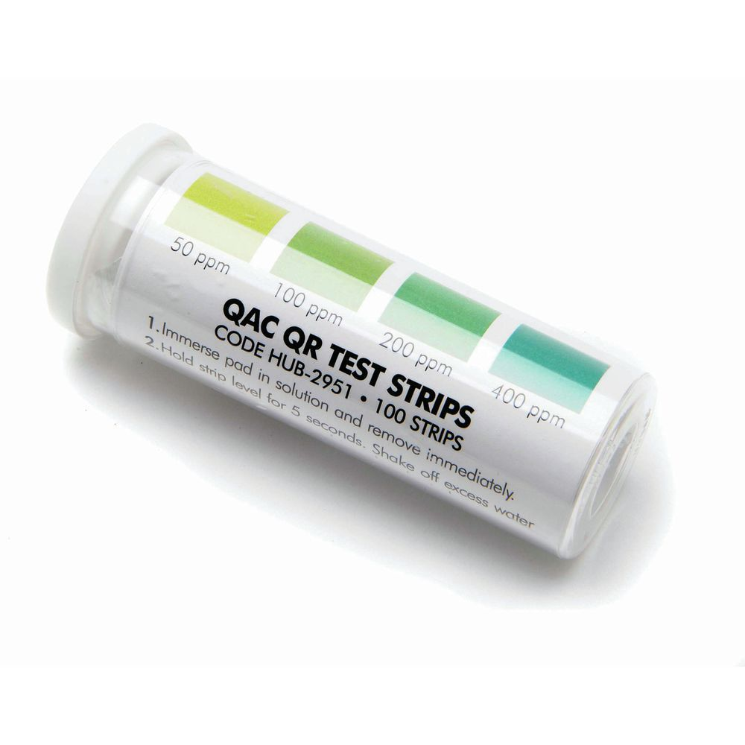
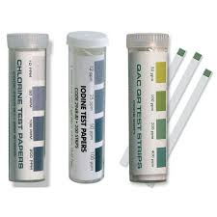
Concentration Verification
The concentration of the disinfectant influences its effectiveness. Therefore it is important to verify the concentration with test strips following mixing the solution and prior to use.
Ensure the strips are for the disinfectant used
Use the strips to ensure the desired concentration is reached.
Mix a new solution if concentration is inadequate
Keep away from water and sunlight

Slide 19
Disinfection for COVID-19 in Healthcare Facilities
CLEANING AGENTS AND DISINFECTANTS USED IN HEALTHCARE FACILITIES
MUST HAVE A DIN (DRUG IDENTIFICATION NUMBER)
LABELLED AS A BROAD-SPECTRUM VIRUCIDE
MAKE SURE TO FOLLOW THE DIRECTIONS ON THE LABEL
ISC (March 2020) Cleaning and Disinfection Guide for Health Care Facilities
Notes:
Broad-spectrum virucide: A disinfectant represented as having efficacy against a representative hard to kill non-enveloped virus, and which is expected to inactivate other non-enveloped and enveloped viruses (i.e., the product has demonstrated “broad-spectrum virucidal” efficacy).

Slide 20
Where to Clean and Disinfect: High Touch Surfaces
Conduct frequent cleaning and disinfection of high touch surfaces within the facility.
Examining tables
Baby weigh scales
Baby change tables
Beds, Bedrails
Cribs
Light Switches
Call Bells
Toilets
Sinks/Taps/faucets
Water coolers
Door knobs/handles
Tables/Chairs
Phones
Computers
Handrails
Countertops
Common areas such as dining areas, lounges, recreational areas, at least twice daily and when soiled.
Reference: PHAC (March 2020) Infection prevention and control for coronavirus disease (COVID-19): Interim guidance for acute healthcare settings

Slide 21
When to Clean and Disinfect for COVID-19
Equipment should be cleaned and disinfected after every use.
High touch surfaces should be cleaned and disinfected a least twice daily and when soiled.
Any equipment (e.g. commodes, blood pressure cuffs, thermometers) that is shared between residents should be cleaned and disinfected before moving from one resident to another.
Any equipment that is shared between residents should be cleaned and disinfected before moving from one resident to another.
Clean the entire room/bed space area, including all touch surfaces (e.g. overhead table, grab bars, hand rails) when someone who is suspected or confirmed for COVID-19 has moved.
Source: BCCDC Infection Prevention and Control for Novel Coronavirus (COVID-19): Interim Guidance for Long Term Care and Assisted Living Facilities http://www.bccdc.ca/Health-Info-Site/Documents/COVID19_LongTermCareAssistedLiving.pdf

Slide 22
Where to Clean and Disinfect: Cleaning upholstered furniture, rugs or carpets
Clean and disinfect when:
Contaminated with emesis or stool, but may be difficult to clean and disinfect completely.
Consult manufacturer’s recommendations for cleaning and disinfection of these surfaces.
If appropriate manufacturer’s recommendations are not available, consult Public Health.
****Consider discarding items that cannot be appropriately cleaned/disinfected, when possible/appropriate.
Reference: AHS (July 2019). Guidelines for Outbreak Prevention, Control and Management in Supportive Living and Home Living Sites

Slide 23
What to Clean: Linens, Clothing and other items to be Laundered
Discard all disposable client/resident-care items and laundering unused linens (e.g., towels, sheets) from client/resident rooms when the isolation precautions have been removed.
Do not shake dirty laundry; this minimizes the possibility of dispersing virus through the air.
Wash items as appropriate in accordance with the manufacturer’s instructions.
Use the warmest appropriate water setting for the items
Dry items completely. Dirty laundry that has been in contact with an ill person can be washed with other people’s items.
Clean and disinfect hampers or other carts for transporting laundry according to guidance for surfaces.
Privacy curtains should be changed if visibly soiled.
Reference: AHS (July 2019). Guidelines for Outbreak Prevention, Control and Management in Supportive Living and Home Living Sites

Slide 24
Personal Protective Equipment (PPE) for Cleaning Staff
Cleaning staff should wear PPE indicated by the manufacturer of the cleaning/disinfection agent
PPE should be compatible with the disinfectant products being used.
Remove ALL PPE carefully after cleaning a room to avoid contamination of the wearer and the surrounding area. Use AHS Donning and Doffing posters as a guide.
ALL PPE must be removed after cleaning a room or area occupied by ill persons.
Cleaning staff and others should perform hand hygiene before donning and after doffing PPE:
Wash with soap and water for 20 seconds especially when visibly soiled.
If hands are not visibly dirty, use alcohol-based hand rub
Cleaning staff should immediately report breaches in PPE (e.g., tear in gloves) or any potential exposures to their supervisor.
Reference: CDC (March 2020) Coronavirus Disease 2019 9COVID-19) Environmental Cleaning and Disinfection Recommendations
Notes:
WHO document: https://apps.who.int/iris/bitstream/handle/10665/331215/WHO-2019-nCov-IPCPPE_use-2020.1-eng.pdf
Cleaners Entering the room of COVID-19 patients - Medical mask, Gown, Heavy duty glove,s Eye protection (if risk of splash from organic material or chemicals), Boots or closed work shoes

Slide 25
COVID-19 Additional Precautions
The following signage should be visible on entry to the client room if a client is suspected or confirmed of COVID-19.
Always remove ALL PPE carefully after cleaning a room to avoid contamination of the wearer and the surrounding area.
Use Donning and Doffing posters as a guide. (on One Health)
Notes:
Additional Precautions are infection prevention and control precautions and practices required in addition to Routine Practices. They are based on the mode (means) of transmission of the infectious agent: airborne, droplet, and contact. For COVID-19 the required Additional precautions are Contact & Droplet.

Slide 26
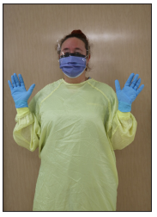
PPE for Cleaning Staff for COVID-19
Contact & Droplet Precautions
Required PPE
Gown
Gloves (non-sterile)
Facial Protection
Procedure mask
Eye protection - Goggles, face shield, or visor

Slide 27
Cleaning and Disinfection Supplies
Gather the necessary supplies
Cleaning cart equipped with cleaning supplies
Cleaner and/or disinfectant solutions and/or ready-to-use wipes
Prepare solution as indicated by manufacturer instructions
Verify concentration with recommended test strips
Where a disinfectant claims to have both cleaning and disinfecting properties, the product may be used for both steps (following manufacturer’s instructions)
Bucket with wringer
Adequate supply of cleaning cloths
Plastic bag/container for dirty cloths
Non-abrasive scrubber
Reference: Health Canada (2016) Environmental Cleaning Module

Slide 28
Cleaning Steps for COVID-19
Identify if Additional Precautions are needed. Signage will be posted on the door.
Perform hand hygiene
Wear appropriate PPE (gloves, gown, face protection (goggles and procedure masks) before entering the room
Use AHS Putting on (Donning) PPE procedure.
Clean room: “high to low”, “walls to center”, “clean to dirty”
Start by door, move clockwise around room to clean
Toilet rooms should be cleaned last
Spot clean walls, baseboards and windows
Clean Damp wipe wall-attached items such as intercom, blood pressure machine, dispensers, and window ledges
Reference: Health Canada (2016) Environmental Cleaning Module

Slide 29
Cleaning Steps for COVID-19
Change cloths/mop heads when:
Visibly soiled.
No longer wet enough to moisten surfaces.
Moving from a dirty area to a clean area.
Exiting a patient room under Additional Precautions.
Clean and Disinfect all high-touch surfaces
Change cleaning cloth frequently
Wipe all horizontal surfaces in room including counters, tables, and chairs.
Remove PPE before leaving the area or client care space
Use AHS Putting on (Donning) and Taking off (Doffing) PPE procedure.
Perform hand hygiene.
Reference: Health Canada (2016) Environmental Cleaning Module

Slide 30
Important considerations:
Select the correct product for the intended task (e.g. cleaning or disinfecting)
Use approved cleaning solutions and disinfectants
Check the expiry date prior to use
The presence of organic soil reduces the effectiveness of disinfectants. Use a two-step process for surfaces that are visibly soiled. Use one wipe to clean and another wipe to disinfect.
Store all disinfectants out of the reach of children and confused individuals
Ensure manufacturer’s recommended wet-contact time is achieved for proper disinfection
Cleaning and disinfecting products must have a Safety Data Sheet (SDS) for staff to refer to at all times and labels must be clearly marked
Wear Personal Protective Equipment (PPE) as required for cleaning and disinfecting
Do not use two different types of cleaning/disinfecting products on the same equipment/environmental surface as the chemicals may react with each other
(e.g. accelerated hydrogen peroxide products and quaternary ammonia products)
Reference: AHS (July 2019). Guidelines for Outbreak Prevention, Control and Management in Supportive Living and Home Living Sites

Slide 31
Environmental Cleaning Resources

Slide 32
Cleaning and Disinfection Guide for Health Care Facilities
Notes:
The guide is a quick summary that can be used to chose a suitable disinfectant generally in your facilty, some guidance on surfaces or objects that should be cleaned, including the procedure as well as frequency.

Slide 33
Environmental Cleaning Training Guide
In 2016, each health centre received a USB stick with the training guide on it.
The complete training guide is now posted on OneHealth
Notes:
Remember the USB stick that were distributed to all regions in 2016? The Environmental Cleaning Training Guide is now located on 1 Health on the coronavirus page. Titles “ Then onwards to communities… now is the time to have another look at this resource
Guidance is provided on:
Dust Mopping
Sweeping
Dry Mopping
Damp Mopping
Vacuuming
Machine Scrubbing/Buffing

Slide 34
Environmental Cleaning
The Environmental Cleaning Training Guide can be found in this section

Slide 35
Where can I find up-to-date information about COVID-19?
Information on COVID-19 changes quickly and is updated frequently. For the most up-to-date information, visit one of the following websites:
One Health Alberta – Coronavirus Page
Alberta Health https://www.alberta.ca/coronavirus-info-for-albertans.aspx
Alberta Health Services https://www.albertahealthservices.ca/topics/Page16944.aspx
Pubic Health Agency of Canada
https://www.canada.ca/en/public-health/services/diseases/2019-novel-coronavirus-infection.html
World Health Organization https://www.who.int/emergencies/diseases/novel-coronavirus-2019
Follow Canada’s Chief Public Health Officer, Dr. Theresa Tam, on Twitter at @CPHO_Canada

Slide 36
Additional Resources for Long Term Care
Alberta Health Services. (July 2020). Guidelines for Outbreak Prevention, Control and Management in Supportive Living and Home Living Sites: Applicable to Lodges, Retirement Residences & Designated Supportive Living Sites
Information for People Visiting Residents and Patients during Pandemic
https://www.albertahealthservices.ca/assets/healthinfo/ipc/hi-ipc-covid19-infosht-visiting-pts-pandemic.pdf
BCCDC Infection Prevention and Control for Novel Coronavirus (COVID-19): Interim Guidance for Long Term Care and Assisted Living Facilities http://www.bccdc.ca/Health-Info-Site/Documents/COVID19_LongTermCareAssistedLiving.pdf
Visitor and Volunteer Screening Questionnaire
https://www.albertahealthservices.ca/assets/info/ppih/if-ppih-visitor-guidance-continuing-care-and-congregate-living.pdf
Poster – Congregate Living Settings /Continuing Care
https://www.albertahealthservices.ca/assets/info/ppih/if-ppih-covid-19-translated-congregate-living-settings.pdf
Poster – Visitor Alert
https://www.albertahealthservices.ca/assets/info/ppih/if-ppih-covid-community-facility-poster.pdf
There is also information at this link for visiting people in the hospital: https://www.albertahealthservices.ca/topics/Page17001.aspx#hospital

Slide 37
Questions??

